Slide 1

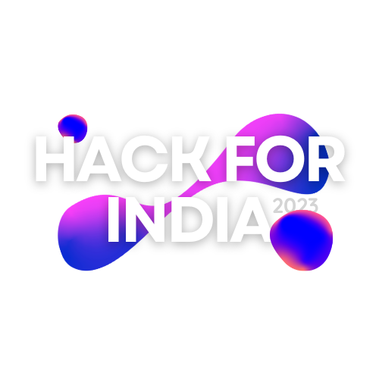
Build for better tomorrow!
Project Title: Gesture Drawing
Team Name: CodeBreaker
Team No: 69

Slide 2
Problem Statement
Paper wastage is harming the environment by using water and trees and creates tons of garbage.Air writing can quickly solve this issue.

Slide 3
Proposed Solution
Nowadays children spent a lotta time scrolling shots and reels which are addictive with no censored content so we created this interface with things in mind like innovative growth and attraction towards the education
and along with this it is a great alternative for the papers as the user will draw the drawing with their gesture on the screen of the computer.

Slide 4
Product - How it works
1. Libraries: The project relies on three main libraries:
• Mediapipe: Used for hand tracking, which provides the coordinates of hand landmarks.
• NumPy: Used for array manipulation and calculations, essential for image processing.
• OpenCV: Used for webcam capture, image processing, and drawing functionalities.
2. Hand Tracking: Mediapipe's hand tracking module is employed to detect and track the user's hand in real-time. It identifies and provides the coordinates of various landmarks on the hand, including fingers and palm.
3. Canvas Creation: A virtual canvas is created using NumPy. The canvas is a NumPy array with specified dimensions, where drawing operations will take place.
4. Drawing Mechanism: OpenCV is utilized to track the movement of the user's hand and draw on the canvas accordingly. The hand landmarks' coordinates obtained from Mediapipe are used to track the hand's position and movement.

Slide 5
Product - How it works
5. Drawing Features: Various drawing features can be implemented, such as changing colors, line thickness, or using different tools (e.g., brush, eraser). These features can be incorporated by extending the existing codebase.
6.User Interaction: The project provides user interaction by capturing video frames from the webcam in real-time and continuously updating the canvas based on hand movements. The canvas is displayed in a separate window, allowing users to observe their drawing in progress.
7. Additional Functionality: Additional functionality can be implemented to save the canvas as an image or clear the canvas when needed. These features can be integrated into the project by extending the existing codebase.
Overall, the air canvas project demonstrates the capability of using computer vision techniques and libraries such as Mediapipe, NumPy, and OpenCV to create an interactive drawing application that tracks hand movements in real-time, allowing users to draw on a virtual canvas.

Slide 6
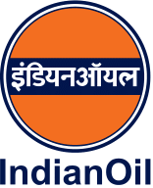
Thank you

